Slide 1
Polyglot Persistence
Polyglot Persistence is a fancy term to mean that when storing data, it is best to use multiple data storage technologies, chosen based upon the way data is being used by individual applications or components of a single application.

Slide 2
Objectives
Disparate Data Storage Needs
Polyglot Data Store Usage
Service Usage over Direct Data Store Usage
Expanding for Better Functionality
Choosing the Right Technology
Enterprise Concerns with Polyglot Persistence
Deployment Complexity

Slide 3
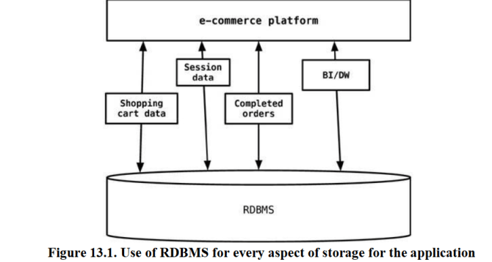
Disparate Data Storage Needs
Many enterprises tend to use the same database engine to store business transactions, session management data, and for other storage needs such as reporting, BI, data warehousing, or logging information.

Slide 4
Disparate Data Storage Needs
The session, shopping cart, or order data do not need the same properties of availability, consistency, or backup requirements.
Does session management storage need the same backup/recovery strategy as the e-commerce orders data?
In 2006, Neal Ford coined the term polyglot programming, to express the idea that applications should be written in a mix of languages to take advantage of the fact that different languages are suitable for tackling different problems.

Slide 5
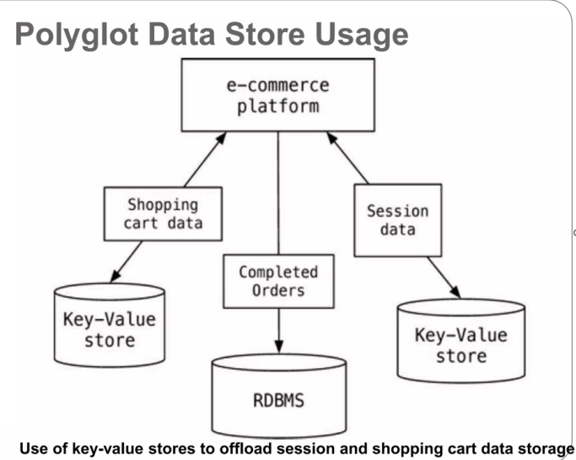

Slide 6
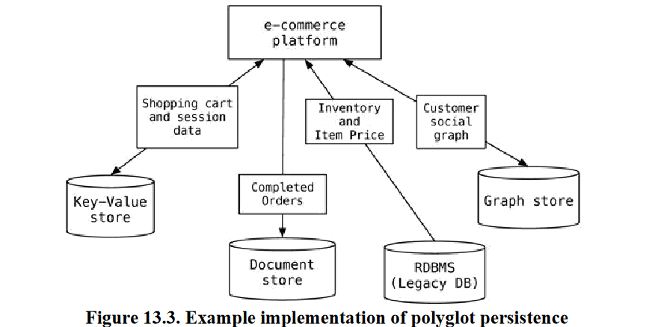
Polyglot Data Store Usage

Slide 7
Polyglot Data Store Usage
It is not necessary for the application to use a single data store for all of its needs, since different databases are built for different purposes and not all problems can be elegantly solved by a singe database.
Even using specialized relational databases for different purposes, such as data warehousing appliances or analytics appliances within the same application, can be viewed as polyglot persistence.

Slide 8
Service Usage over Direct Data Store Usage
As we move towards multiple data stores in the application, there may be other applications in the enterprise that could benefit from the use of our data stores or the data stored in them.
Using our example, the graph data store can serve data to other applications that need to understand, for example, which products are being bought by a certain segment of the customer base.
Instead of each application talking independently to the graph database, we can wrap the graph database into a service so that all relationships between the nodes can be saved in one place and queried by all the applications.
The data ownership and the APIs provided by the service are more useful than a single application talking to multiple databases.

Slide 9
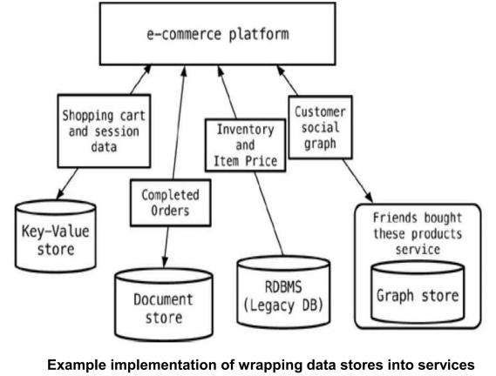

Slide 10
The philosophy of service wrapping can be taken further:
You could wrap all databases into services, letting the application to only talk to a bunch of services.
This allows for the databases inside the services to evolve without you having to change the dependent applications.

Slide 11
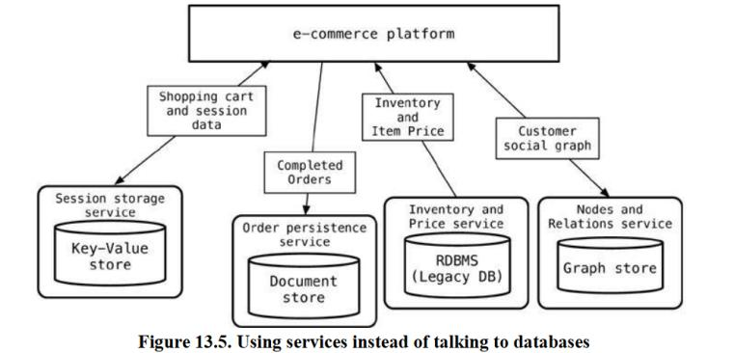

Slide 12
Expanding for Better Functionality
we cannot really change the data storage for a specific usage to something different, because of the existing legacy applications and their dependency on existing data storage.
We can, however, add functionality such as caching for better performance, or use indexing engines such as Solr so that search can be more efficient.
When technologies like this are introduced, we have to make sure data is synchronized between the data storage for the application and the cache or indexing engine.

Slide 13
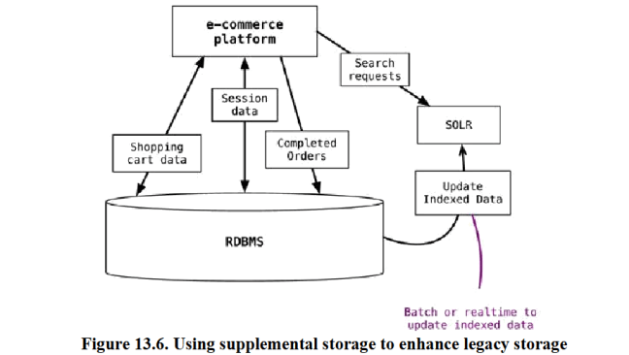

Slide 14
While doing this, we need to update the indexed data as the data in the application database changes.
The process of updating the data can be real-time or batch, as long as we ensure that the application can deal with stale data in the index/search engine.

Slide 15
Choosing the Right Technology
Rich choice of data storage solutions
Single RDBMS database which allows all types of data models to be stored
If we want to recommend products to customers based on what’s in their shopping carts and which other products were bought by customers who bought those products, it can be implemented in any of the data stores by persisting the data with the correct attributes to answer our questions.
The trick is to use the right technology, so that when the questions change, they can still be asked with the same data store without losing existing data or changing it into new formats.

Slide 16
We can use RDBMS to solve this using a hierarchal query and modeling the tables accordingly.
When we need to change the traversal, we will have
To refactor the database
migrate the data
start persisting new data.
Instead, if we had used a data store that tracks relations between nodes, we could have just programmed the new relations and keep using the same data store with minimal changes.

Slide 17
Enterprise Concerns with Polyglot Persistence
Introduction of NoSQL data storage technologies will force the enterprise DBAs to think about how to use the new storage.
The enterprise is used to having uniform RDBMS environments; whatever is the database an enterprise starts using first, chances are that over the years all its applications will be built around the same database.
In this new world of polyglot persistence, the DBA groups will have to become more poly-skilled—
to learn how some of these NoSQL technologies work,
how to monitor these systems
back them up
take data out of and put into these systems.

Slide 18
Once the enterprise decides to use any NoSQL technology, issues such as
Licensing
Support
Tools
Upgrades
Drivers
Auditing
security come up.
Many NoSQL technologies are open- source and have an active community of supporters; also, there are companies that provide commercial support.
There is not a rich ecosystem of tools, but the tool vendors and the open-source community are catching up, releasing tools such as MongoDB, Datastax, Raik

Slide 19
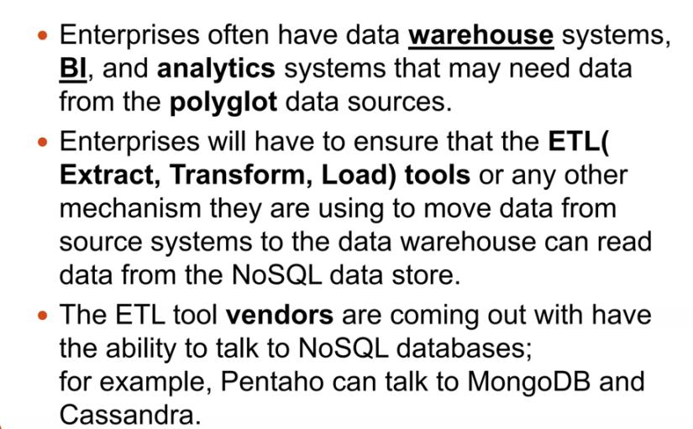

Slide 20
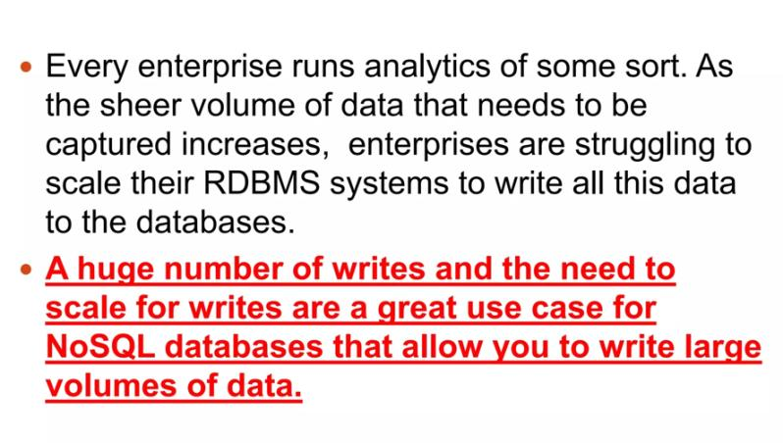

Slide 21
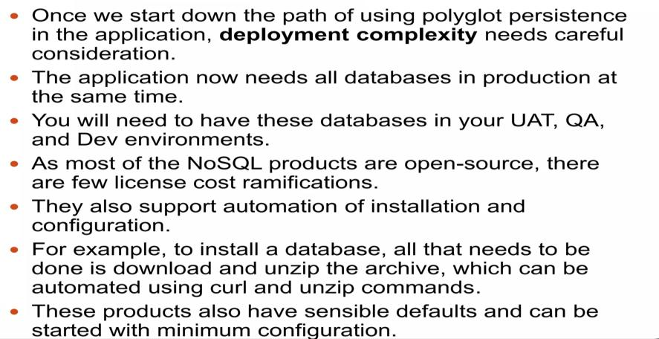
Deployment Complexity
Notes:
User Acceptance Testing UAT

